Slide 1
Police Bot: Enhancing Social Media Governance with Policing Bots
Milestone 1 Presentation

Slide 2
Group Members:
Students:
Liam Dumbell
Gabriel Silva
Cody Manning
Faculty Advisor / Project Client:
Khaled Slhoub
Computer Science Project Instructor:
Philip Chan

Slide 3
Overview:
Comparing Technical Tools
Discussion on finalized collaboration tools
Discussion on Requirements, Design, Test and Milestone 1 Progress Evaluation Documents
Tweepy Demo Video
Discussion on resolved and new Technical Challenges
Plans and Adjustments heading into Milestone 2

Slide 4
Comparing Technical Tools:
Tweepy: Allows users to connect to existing Twitter accounts. Allows users to Post Tweets on the linked account. Allows users to scan individual Twitter account data.
Flask Application Approach: Has similar functionality to Tweepy, but has far more setup involved. Decided to be out of the scope of our project due to this approach involving stockpiling access tokens in a database, which gets very expensive.

Slide 5
Collaboration Tools:
Software Development: Github (most efficient way of storing all relevant code)
Documents / Presentations: Google Docs, Google Slides and Powerpoint
Communication Method: Discord
Task Calendar: Google Calendar

Slide 6
Requirements Document:
Detailed Requirements for the following functionalities of our framework:
Bot Creation
Bot Scheduling
Bot Discovery
Bot Distinguishing
Data Storing
Detailed non-functional requirements:
Performance
Security
Maintenance / Support

Slide 7
Design Document:
Created a conceptual model of our Police Bot Framework
Created a UML diagram for our Police Bot Framework
Added a detailed description of each module in the UML diagram
Created an exemplified pseudocode description of the framework
Created a mock-up of what our Graphical User Interface (GUI) for our framework could look like.

Slide 8
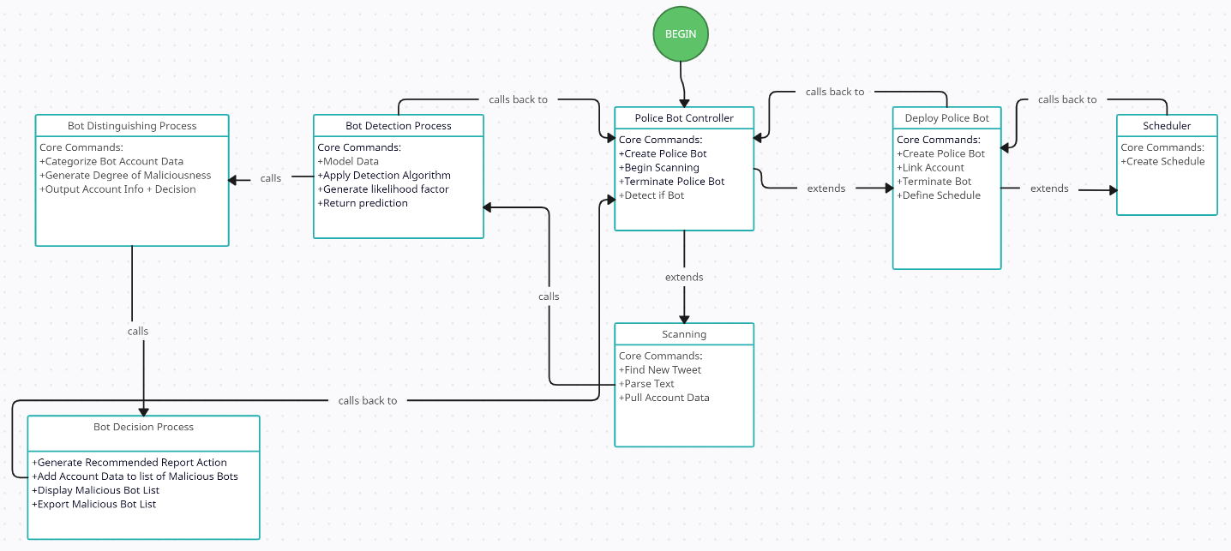
UML Diagram

Slide 9
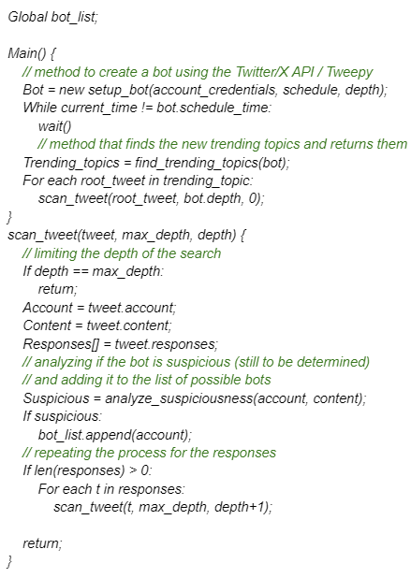
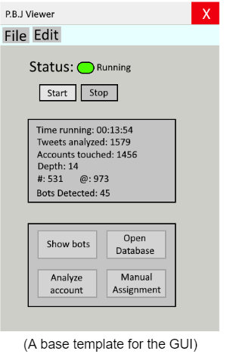
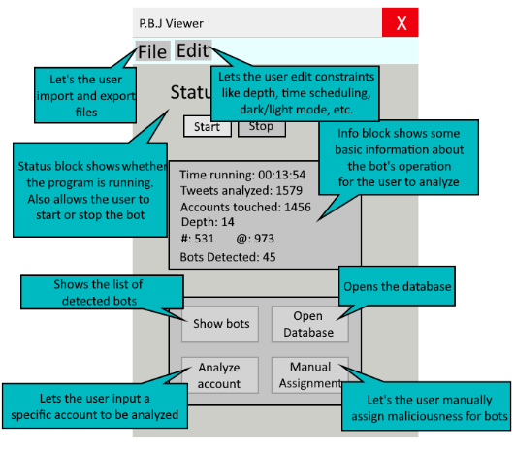
Exemplified Pseudocode
GUI
GUI Description

Slide 10
Test Plan:
Decided on methods and created testing strategies for the following:
Detect Function
Distinguish Function
Decide Function
Each of these Functionalities will go through the following where the expected result is predefined in terms of output accuracy:
Unit Testing
Integration Testing
System Testing

Slide 11
Milestone 1 Progress Evaluation:
The following was thoroughly detailed for our client who overviewed the Progress Evaluation document along with the others:
What progress was made on each task (Selecting Technical Tool, Creating “Hello World Demo”, Creation of Requirement, Design, Test Plan documents)
How each member contributed to each of these tasks
Discussion on what tasks need to be completed for Milestone 2
Outlining Client feedback and future meeting times
Creation of a Task Matrix for Milestone 1 and 2

Slide 12
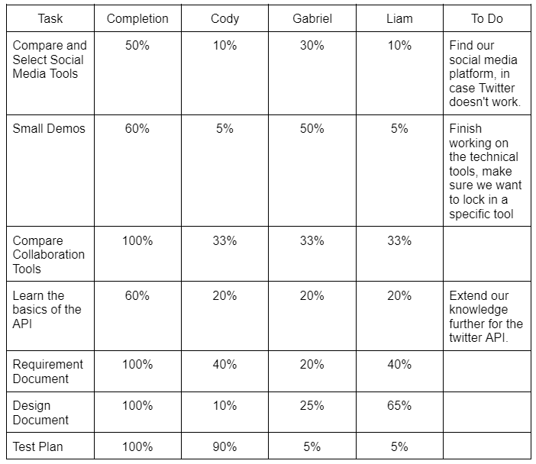
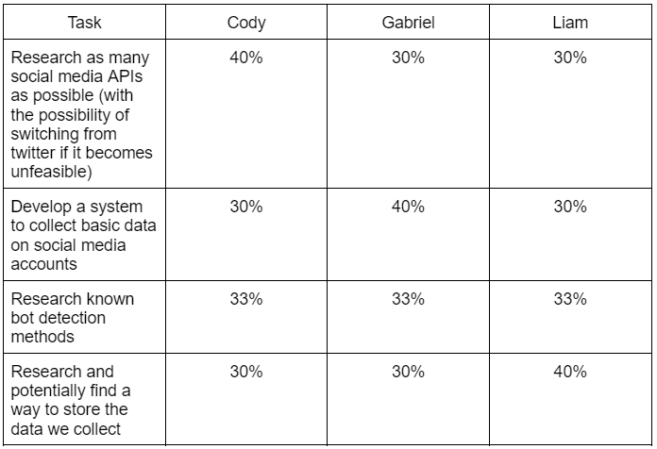
Milestone 1
Milestone 2

Slide 13
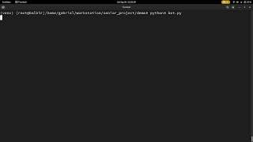
“Hello World” Demo for Tweepy Technical Tool
https://www.youtube.com/watch?v=lRa18QOQcg8

Slide 14

Technical Challenges Update:
Progress on resolving challenges:
Gained rudimentary experience working with the Twitter API
Gained rudimentary experience working with the Twitter Virtual Environments
Gained rudimentary experience working with and coding Bots
Gained rudimentary experience working with the Tweepy Library
Expanded HTML knowledge
New Technical Challenges:
The free plan for the Twitter API does not let users search, scan or reply to Tweets (paid subscriptions allow this functionality but are $100 / Month). This significantly complicates our project plan and means we may have to look into shifting our focus to Reddit, Facebook or Instagram if we cannot get funding from the university.
Little to no knowledge using Reddit, Facebook and Instagram APIs
Research must be done to resolve this issue

Slide 15
Moving Towards Milestone 2:
Resolve Twitter API issue or shift focus to another social media platform
Conduct extensive research on various tools that are available for other social media platforms (Reddit, Facebook, Instagram)
Create efficient systems within our framework that can interact and retrieve all relevant data from social media accounts.
Review academic research provided by Dr. Slhoub on detecting bot accounts and decide on a method / methods of detection.
Create an efficient account data storage solution, either by creating a locally hosted database or by using AWS
Ensure we stay within GDPR (General Data Protection Regulation)
Create a small Demo of our current account data retrieval and storage method

Slide 16
This concludes our presentation, Thank You

